Slide 1












Perfect StudyMate
Weekly progress meeting
SWE3028-Fall-2024 Team K
Juyong Rhee | Yewon Chun | Jihee Hwang | Jorge Alcorta

Slide 2






Contents
01
02
Role Division
Working Progress
03
04
What we’ve done
What to do

Slide 3













Role Division
Juyong Rhee
Yewon Chun
- Team Leader
- BackEnd Development
RAG based Model Development
Documentation
Jihee Hwang
Jorge Alcorta
UI/UX Designmer
FrontEnd Development
RAG based Model Development
Presentation

Slide 4


Working Progress
 | Week5 | Week6 | Week7 | Week8 | Week9 | Week10 | Week11 | Week12 | Week13
Langchain & RAG Study
AI Structure Design
AI Architecture Development
Database Design
API Specification
API Integration
API Implementation
UI/UX Design
FrontEnd Implementation
Integration Testing

Slide 5

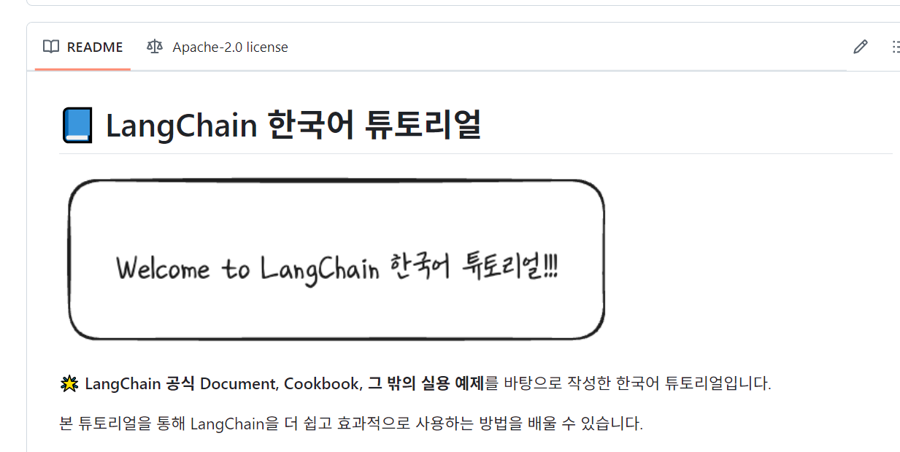




What we have done
01
Langchain & RAG Study
Before participating in the development of the model,
Study some basic knowledges about Langchain & RAG
Yewon
Prompt?
Retrieval?
Vector
Database?

Slide 6

What we have done
01
Langchain & RAG Study | Rough Review
Prompt Phase
The process generating a question or command for language model.
- responsible for setting language models to work in specific contexts
- Integrates perspectives and content from multiple documents, and processes them in a direction that models can utilize
- A well-organized promport commands the model to output a more accurate response

Slide 7
What we have done
01
Langchain & RAG Study | Rough Review
LLM Phase
LLM phase generates appropriate answer using Large Language Model (LLM) based on processed input of prompt phase.
Why LLM?
LLM has deep understanding of structure and meaning of languages. Based on this capability, LLM can generate more natural and informative response.
LLM generates responses by considering the given context. It can respond more accurately to the user's questions. In addition, it answers based on information provided by users other than pre-trained knowledge by referring to the context.

Slide 8
What we have done
01
Langchain & RAG Study | Rough Review
Embedding Phase
Embedding phase convert splitted documents into numerical forms that machine can understand its meaning.
Why embedding?
Natural languages are very complex and contain many different meanings. By converting these texts into quantified forms through embedding, computers can better understand and process the content and meaning of documents.
Transformation into numerical vector form is essential in calculating the similarity between documents, which facilitates the task of searching for relevant documents or finding the documents that best fit your question.

Slide 9
What we have done
01
Langchain & RAG Study | Rough Review
Vector-Storing Phase
Steps to effectively store and manage embedding vectors
Why Vector Store?
Fast
Search
Scalability
Semantic
Seach
Allows to look up similar paragraphs in context to your questions, rather than search based on keywords

Slide 10
What we have done
Vecotrize user queries
Compare vector similarity
Select top similarity paragraph
Return information
01
Langchain & RAG Study | Rough Review
Retrieval Phase
Search documents stored in vector database which is highly relative to user’s query.

Slide 11
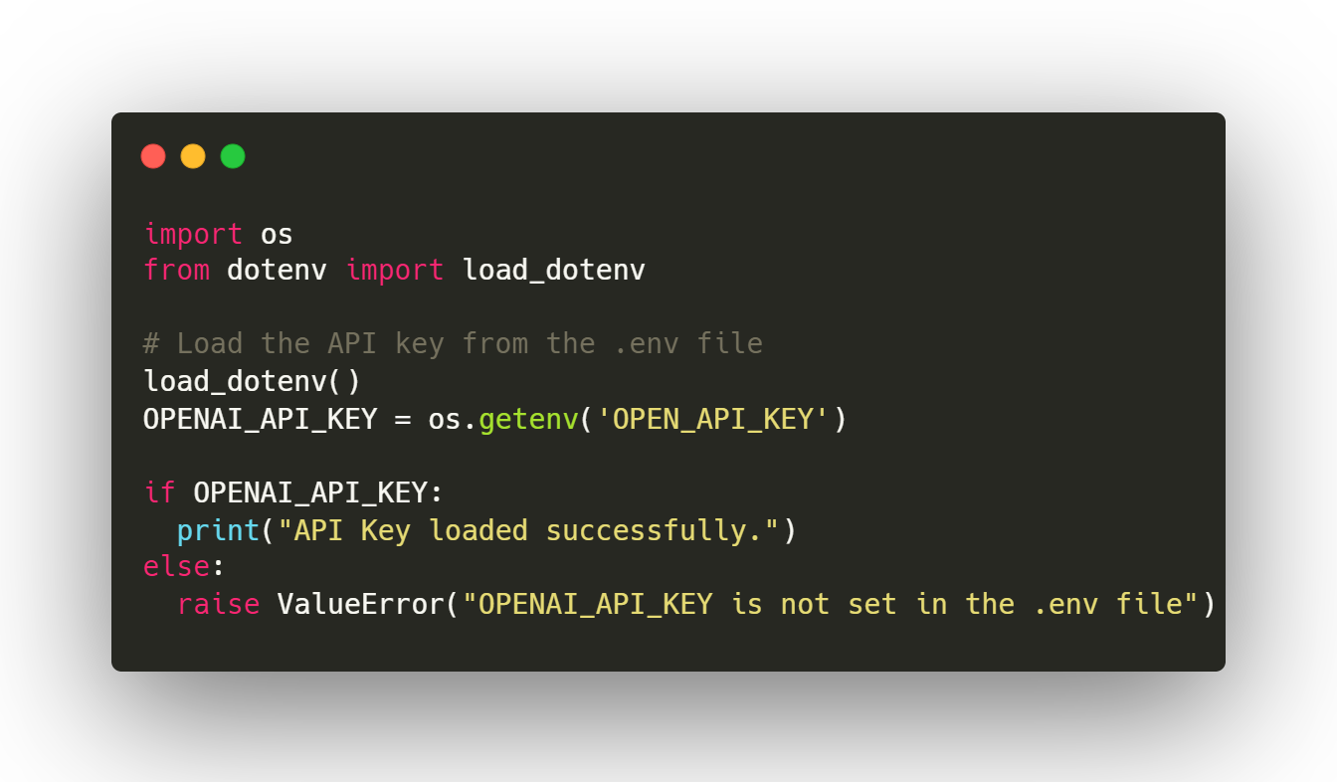
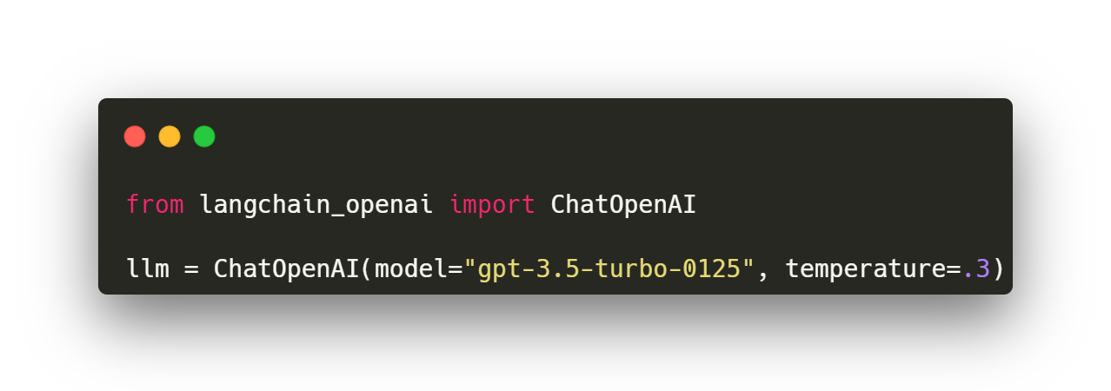
What we have done
02
AI Modeling | LangChain + OpenAI GPT3.5 setup
▲ Create Large Language Model (LLM) Object

Slide 12
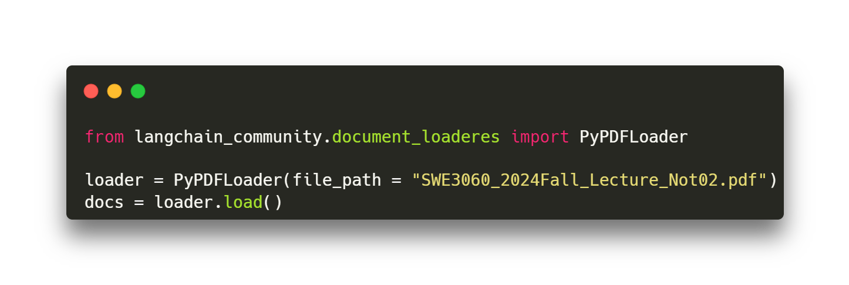
What we have done
02
AI Modeling | Load Documents
▲ Load Example .pdf File for RAG

Slide 13
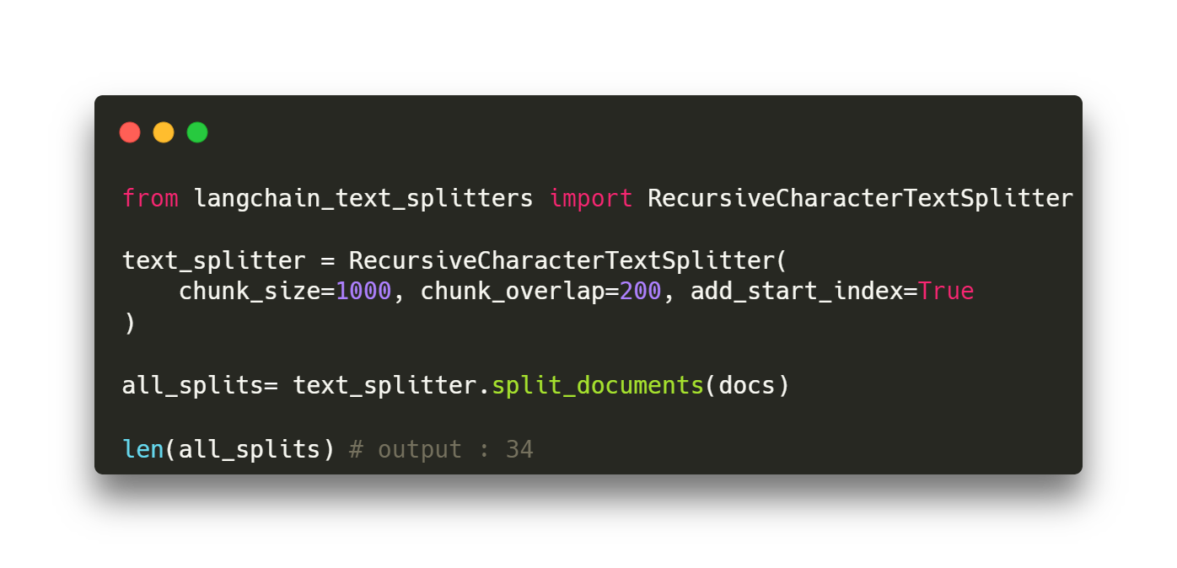
What we have done
02
AI Modeling | Split Documents
◀ Chunk loaded documents

Slide 14
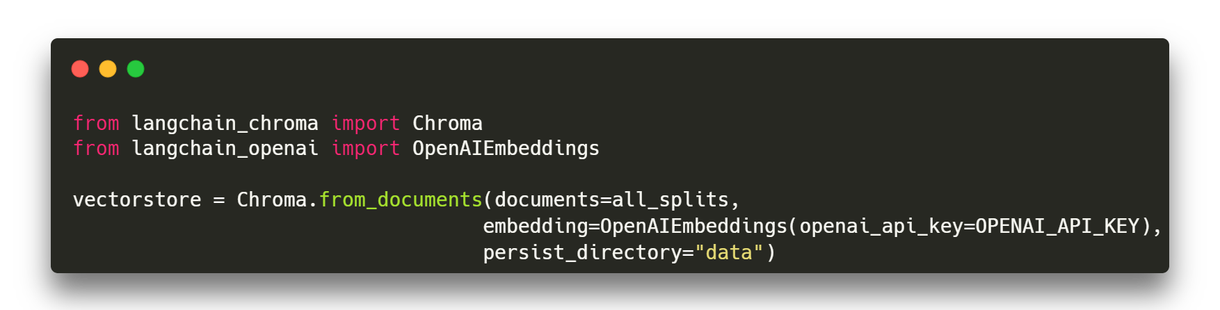
What we have done
02
AI Modeling | Store Splits
▲ Embed dataset and create Chorma vector-storage

Slide 15
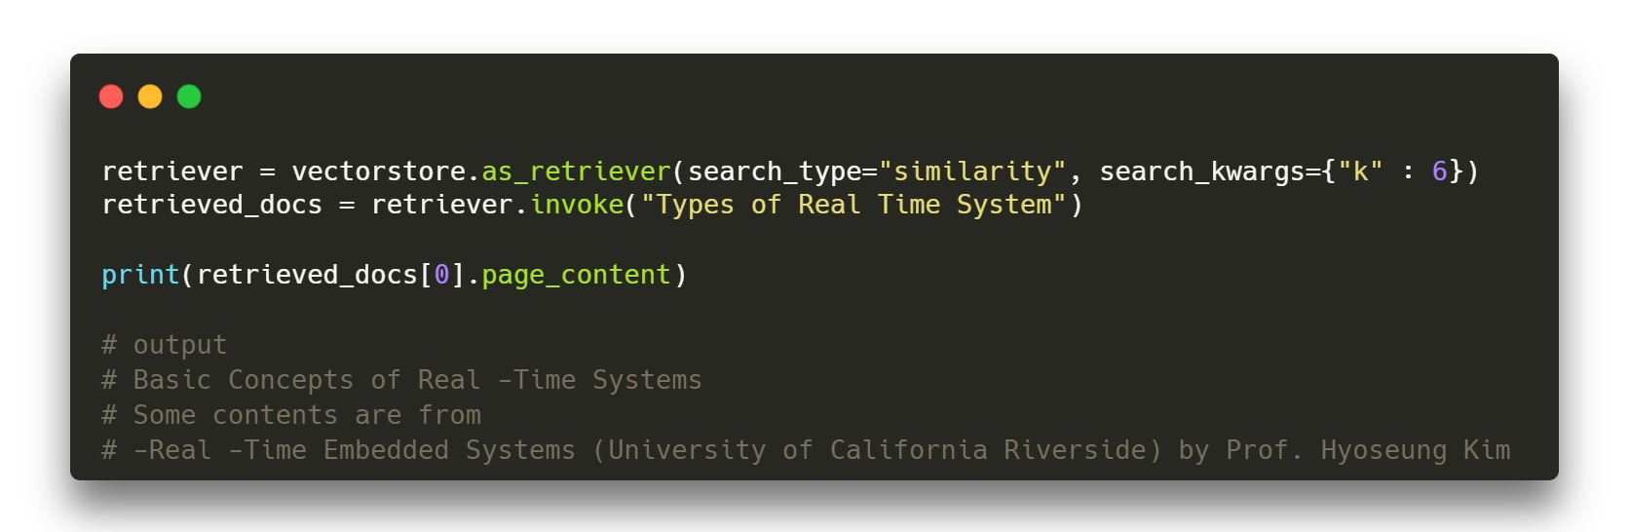
What we have done
02
AI Modeling | Retrieval

Slide 16
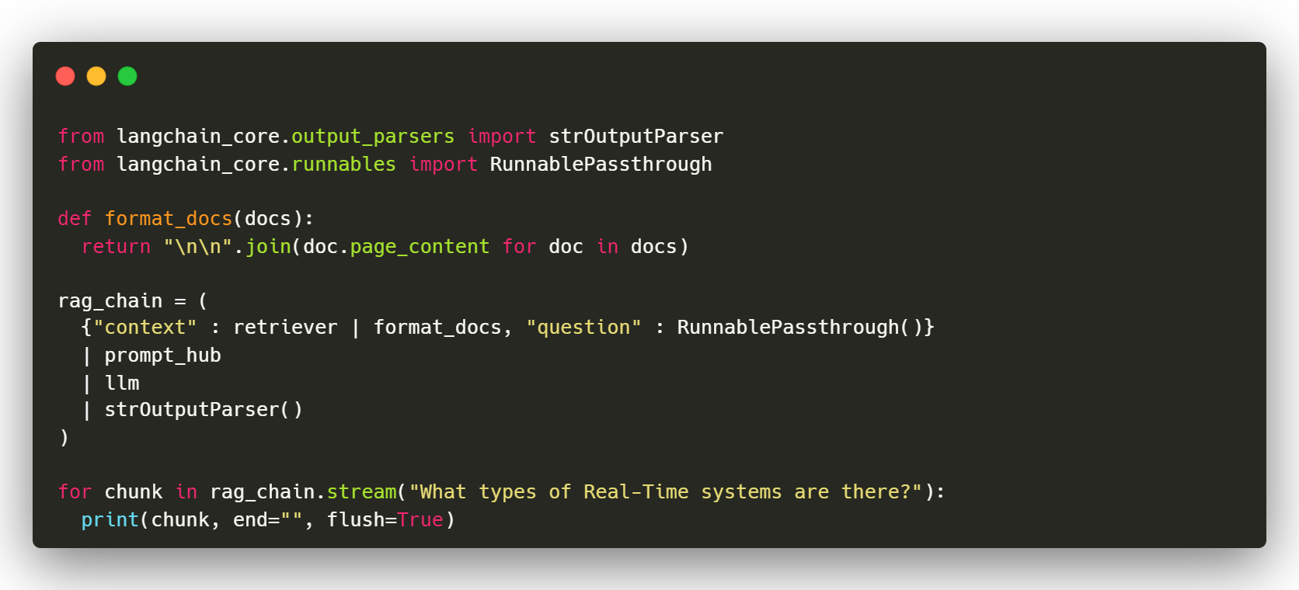
What we have done
02
AI Modeling | Runnable
◀ Struct RAG chain
◀ Run RAG chain with question

Slide 17

What we have done
02
AI Modeling | Obtained Output
Real-Time systems can be classified into hard real-time systems, soft real-time
systems, and firm real-time systems. Hard real-time systems have disastrous
consequences if deadlines are missed, while soft real-time systems have
performance degradation if deadlines are missed. Firm real-time systems fall
between hard and soft real-time systems …
Our Base Model
Jorge

Slide 18


What we have done
03
BackEnd | Overview
User
Chatroom
Sign Up
Create chatroom
Find all chatrooms
Find chatroom by chatroom_id
Auth
Login
Message
Send message to model

Slide 19
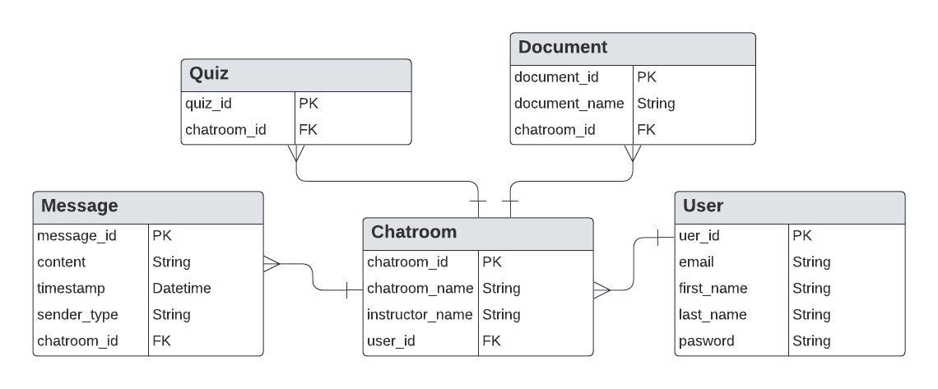

What we have done
03
BackEnd | ERM Diagram

Slide 20
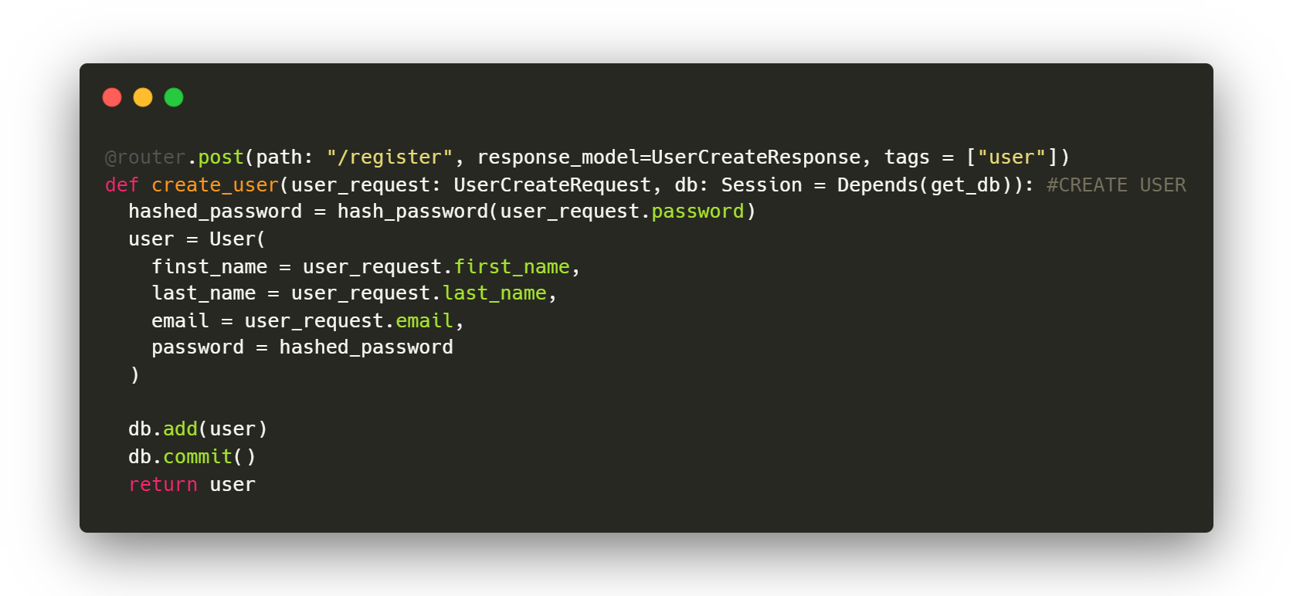
What we have done
03
BackEnd | User : POST /user/register

Slide 21
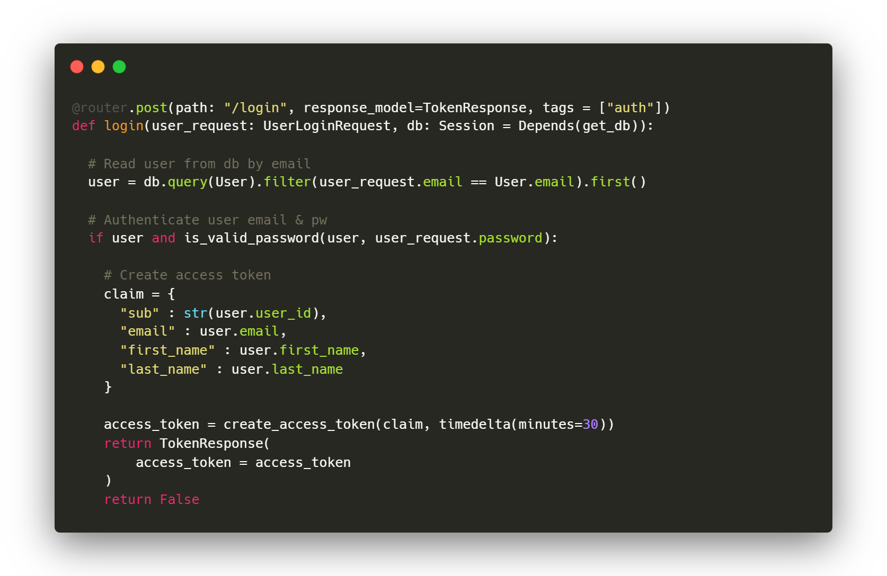
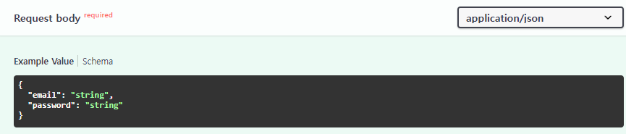

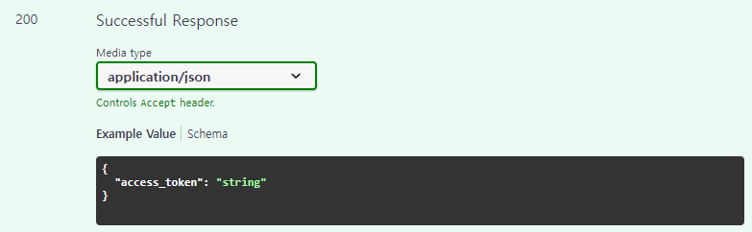
What we have done
03
BackEnd | Auth : POST /Auth/login
Request Body
Response

Slide 22
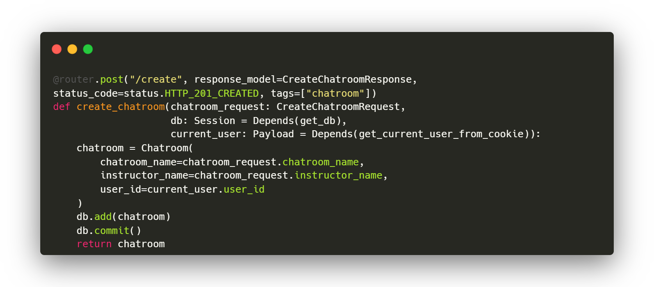
What we have done
03
BackEnd | Chatroom : POST /chatroom/create

Slide 23
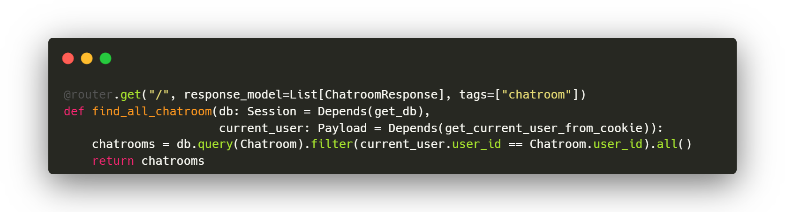
What we have done
03
BackEnd | Chatroom : GET /chatroom
▲ Get all chatrooms of the user

Slide 24
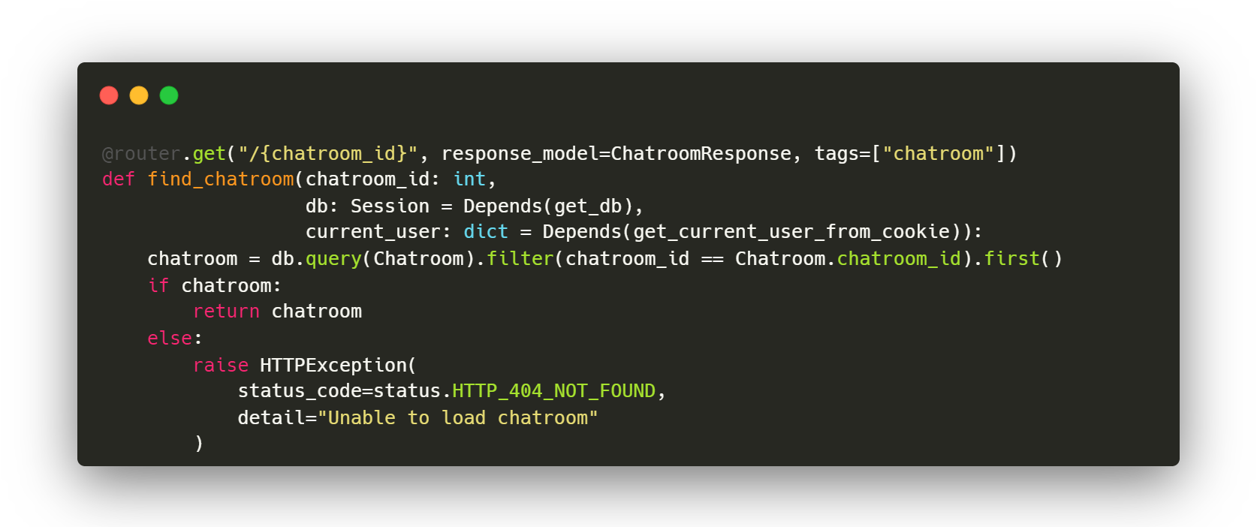
What we have done
03
BackEnd | Chatroom : GET /chatroom/{chatroom_id}
▲ Get a specific chatroom of the user based on chatroom_id

Slide 25
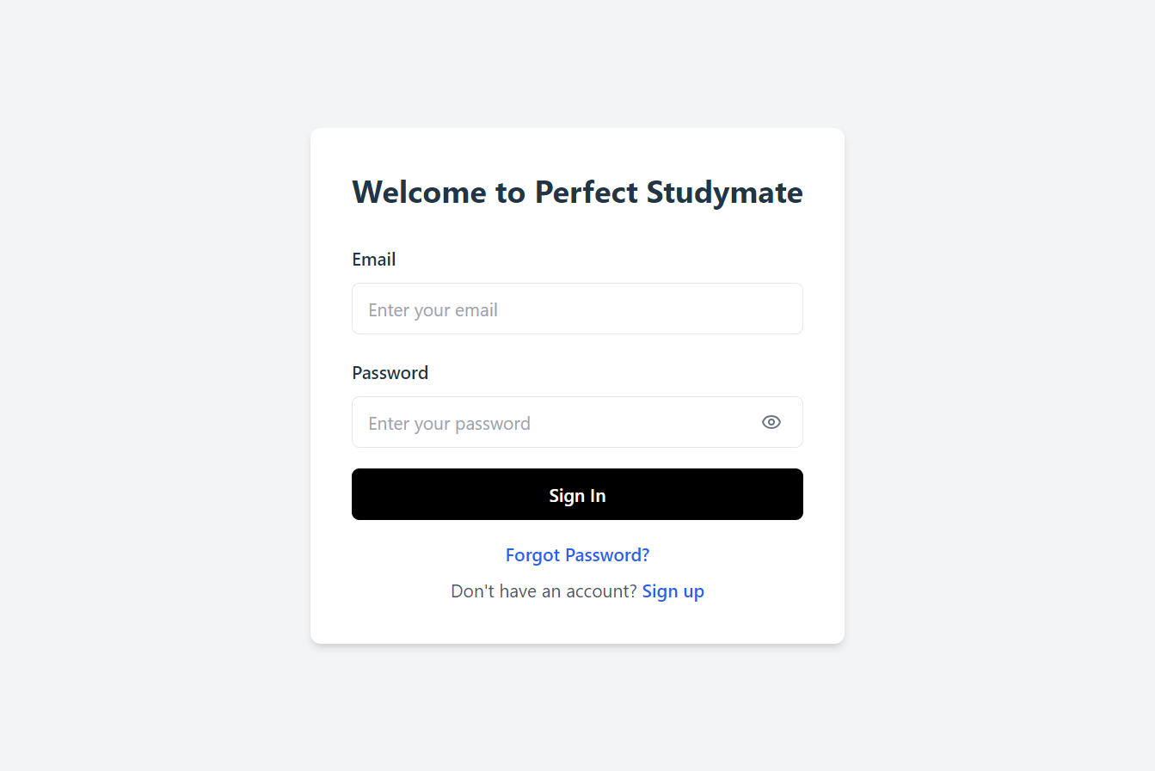
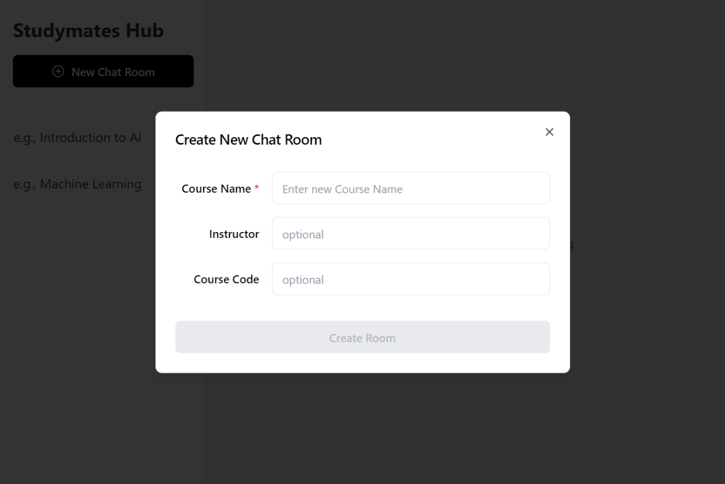
What we have done
04
FrontEnd | Demo UI design using Figma
▲ Login Intergace
▲ Chat Interface

Slide 26






What we have done
04
FrontEnd | FrontEnd Base Setup
Core Tech Stack
CSS and UI components
React
Shadcn UI

Slide 27


What we have done
04
FrontEnd | FrontEnd Base Setup
Development Env
Code Style & Linting

Slide 28
What we have done
04
FrontEnd | Implement Login
Responsible for handling user login.
◀ A form where user can enter their email and password
◀ Enter password with options to toggle password visibility
◀ Submit the form
▲login.jsx

Slide 29




Next Step!
Juyong Rhee
Yewon Chun
Develop Message API
Develop Quiz API
Error Handling and Testing
More RAG practice
Model Evaluation, upgrade model
Jihee Hwang
Jorge Alcorta
Develop Chatroom Frontend implementation
- Code Refactoring
- Model Evaluation, Upgrade Model

